Slide 1
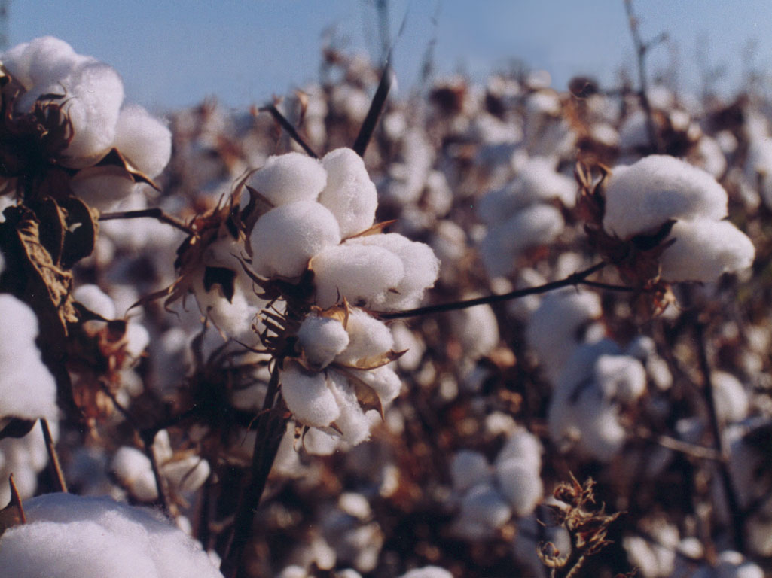
ClothesManu
Blockchain Enthusiasts

Slide 2
Your biggest incentive is:
the consumer.
How is our audience changing?
Tech-savvy
passionate about environmental well-being
a supporter of social activism and change

Slide 3
What is the problem?
The consumer is often unaware of the true value of clothing.
Too often, the way clothing is marketed is not transparent and there is an obfuscated production line which allows for law and regulation to be maintained on a technicality. This can include:
Rendering the country of origin of an item to where the tags are sewn on.
Relying on their hype and brand to enforce inflated prices.
Child and sweatshop labour is not transparent.
Lack of transparency about the origin of material.

Slide 4
Our Solution

Slide 5

Let’s revolutionise the manufacturing process with blockchain...
If all aspects of the production journey are kept on record, we could see the journey of our clothes and make better decisions in what we are buying.
This process leverages the immense benefits of blockchain.
Security
Trust
No more intermediary

Slide 6
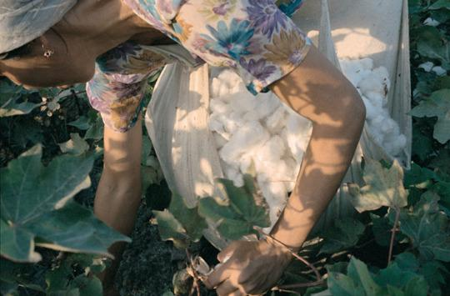
Notes:
From the origin of materials, documented on our blockchain

Slide 7
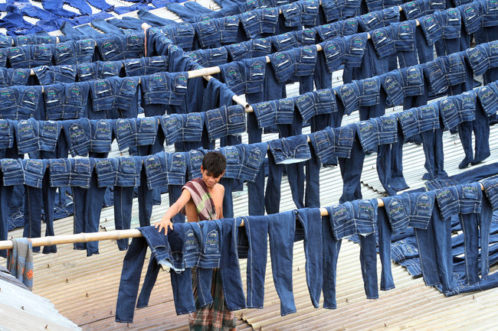
Notes:
To factories manufacturing the clothing

Slide 8
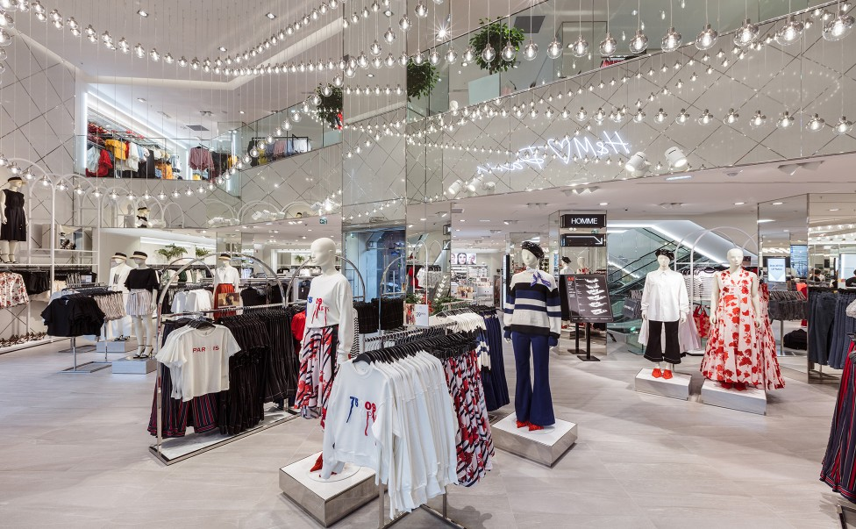
Notes:
To the suppliers & fashion realtors which out-source this production
The consumer is also aware of this transparency - through either interactive QR code, or printed information

Slide 9
Incentive to the Manufacturer & Supplier
Our target audience skews towards companies and brands with an interest in developing a more conscientious brand.
But eventually, this system can infiltrate the large culprits at hand - the mega fast-fashion chains.
By digitalising this auditing process, we are providing many benefits to the manufacturer/ supplier:
Easy documentation & communication between remote factories.
Transparent business communication re: shipping, tracking, volume.
Rids paper trail, removes third party auditors, archivers etc.
Being open source, promotes a discourse about sustainability/ ethicality.

Slide 10

Sustainable fashion is the future.

